Slide 1

Predicting the price of diamonds
How the four Cs shape the cost of these precious jewels

Slide 2
Process
I created a model to predict the price of a diamond based on known data on prices and the diamonds’ cut, clarity, color, and carat.
I used supervised machine learning and a linear regression model as the base.
I used 60 percent of the data to train the model, and then tested the model with the remaining 40 percent of the data.
I then interpreted the model’s accuracy by examining its predictions, generating an “accuracy score”, and examining error by looking at the mean absolute error, the mean squared error, and the root mean squared error.
Lastly, I cross-validated the model to ensure my train-test-split method (described above) was truly random.

Slide 3
Results
My model is pretty accurate.
The accuracy score for the model is just over 90 percent.
While the error scores are a little higher than I’d like to see, they are acceptable. (There is no cut-off, but the lower the scores the better). My model’s scores were:
Mean absolute error: approximately 856
` Mean squared error: approximately 1475535
Root mean squared error: approximately 1215
My check on the randomness of my method resulted in good scores. I ran five iterations and each had a score of approximately 90 percent.

Slide 4
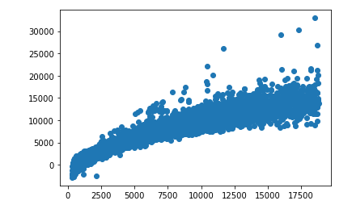
Examining predictions
This chart looks at the predictions generated by the model compared to the actual values from the data frame.
Generally, the straighter the line, the better.
As you can see, our graph isn’t fantastic, but it’s OK.

Slide 5
Conclusions
Our model according to the accuracy score is about 90 percent accurate.
We didn’t get the best error scores, but the model is still relatively accurate.
Our test to ensure randomness in the splitting method of our data ensures us it was done randomly.
We can be fairly confident in relying on the model to predict diamond prices.

